Slide 1
CEE263: Numerical Weather Prediction
Jan Stepinski
June 8, 2015

Slide 2
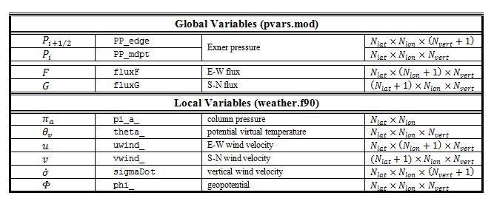
The Grid
Single physical grid vs. multiple numerical grids
Nodes at which solutions are evaluated coincide either with the edges or centers of cells on the physical grid
Global variables are instantaneous; they are entirely reevaluated with each Matsuno step
System variables propagate over time; a new value depends on one or more previous instances
Variable name = base property + flavor suffix

Slide 3
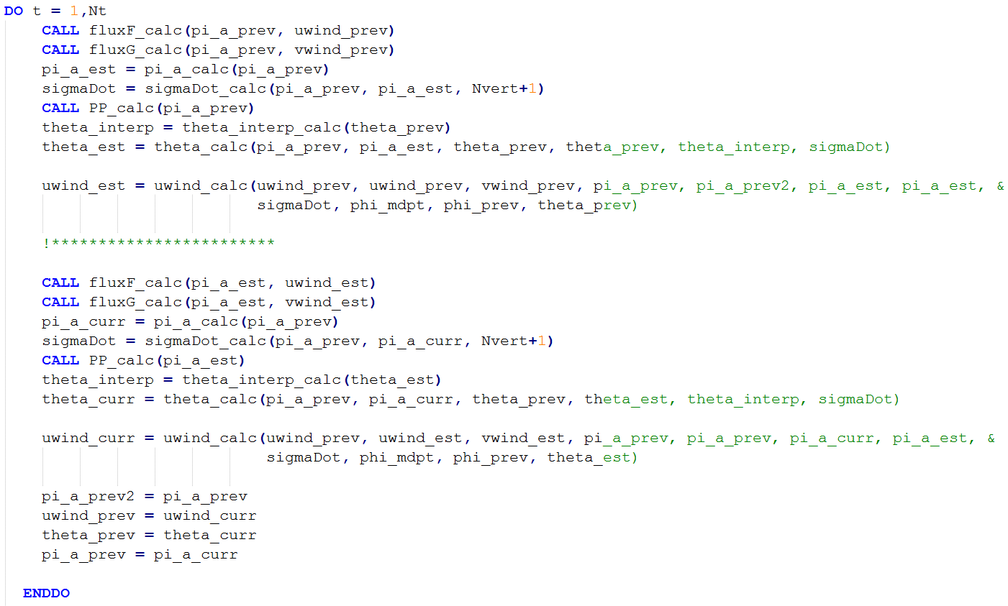
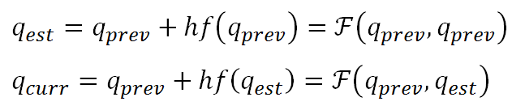
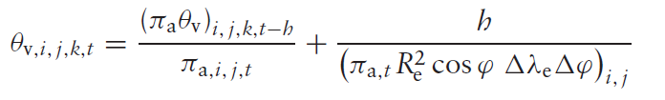
Matsuno Scheme

Slide 4
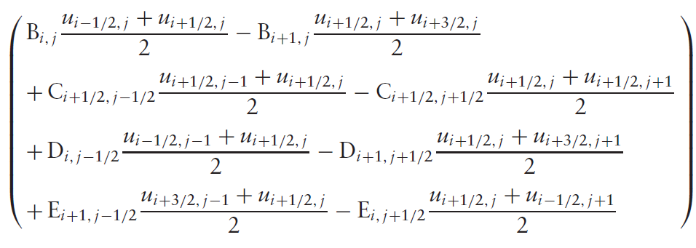

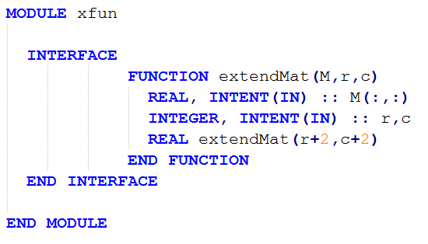
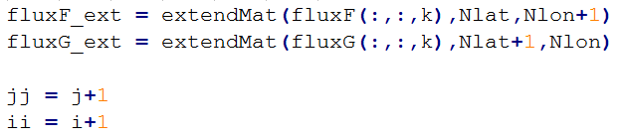
Neumann

Slide 5
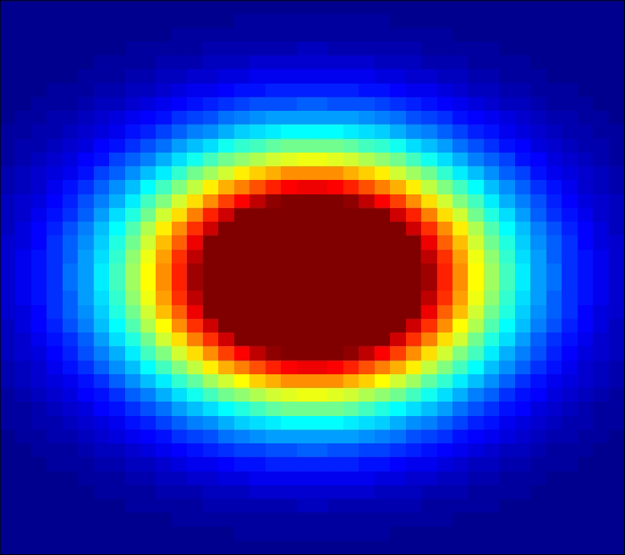
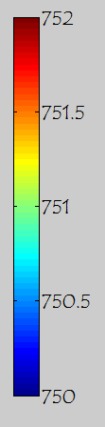

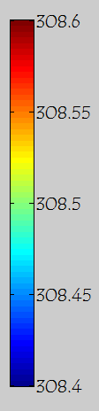
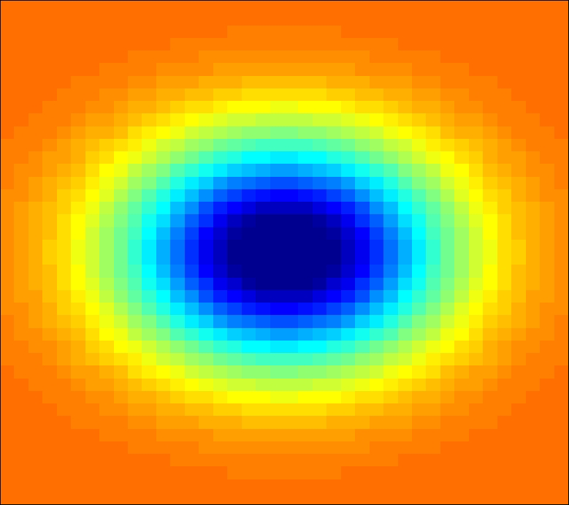
Flat

Slide 6
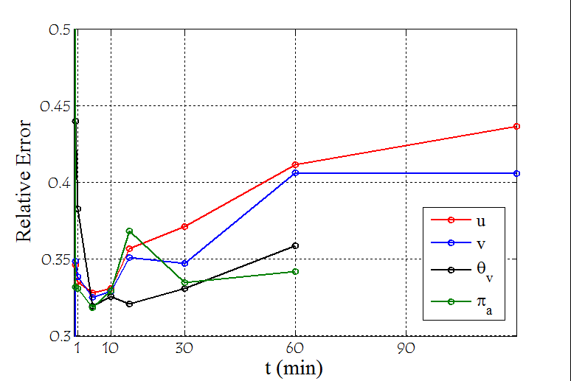
Temporal Accuracy
Run model at h = 0.5, 1.0, and 2.0 sec for 2 hours, recording properties at specific times.
Treat simulation with h = 0.5 as closest approximation of truth, and compute L2 error between it and the other simulations
Compute ratio between L2 errors
Verify Matsuno is accurate of order 1 in time

Slide 7
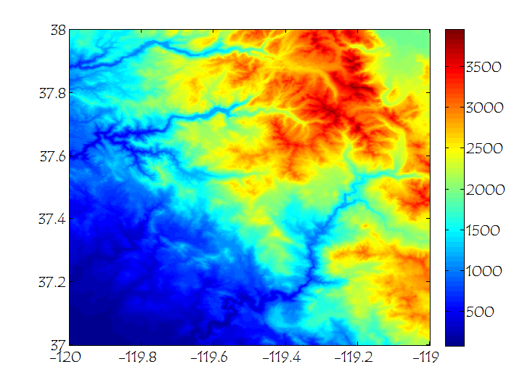
Yosemite

Slide 8
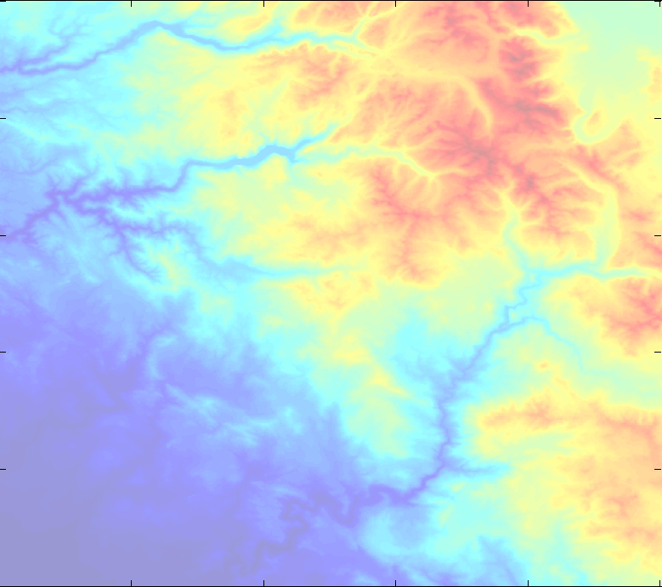
Yosemite

Slide 9
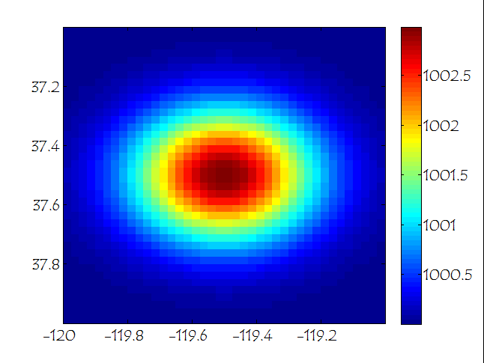
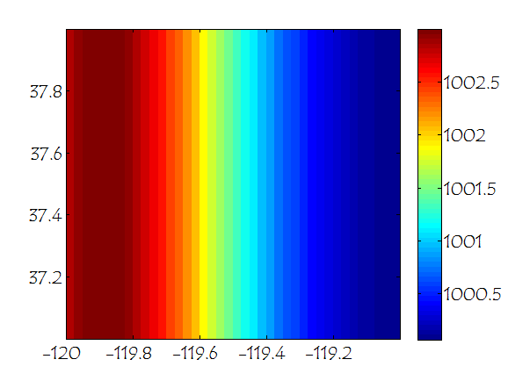
Yosemite
Initial pressure gradient to replicate low pressure over mountains…
…but the gradient was too small relative to the topography to produce any noticeable changes in the simulation.

